Slide 1
Jupiter
Earth
Earth closest to Jupiter
Sun
light takes an extra 16 minutes
to travel the extra distance 2R_{SE}
Earth farthest from Jupiter

Slide 2
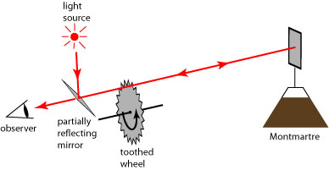
mirror
light source
d
observer
partially reflecting mirror
rotating notched
wheel

Slide 3
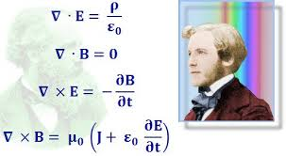
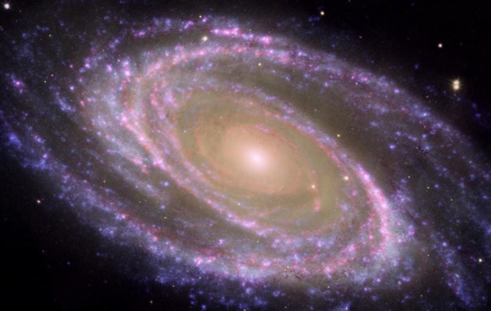

Slide 4
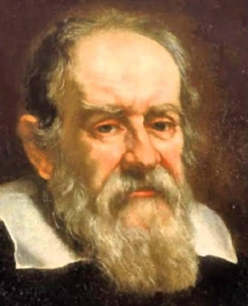
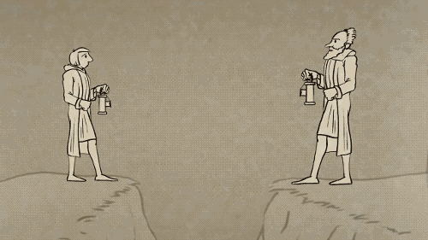

Slide 5
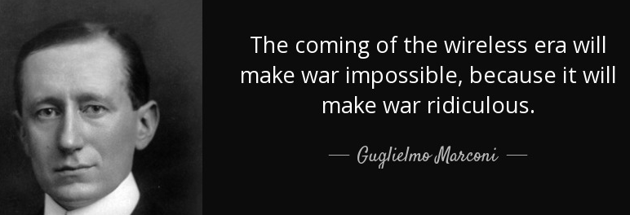
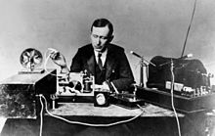

Slide 6
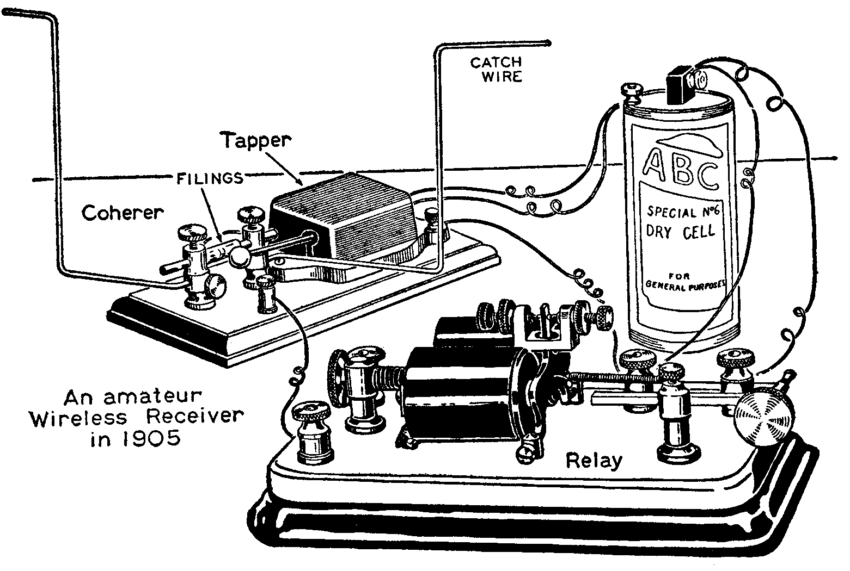

Slide 7
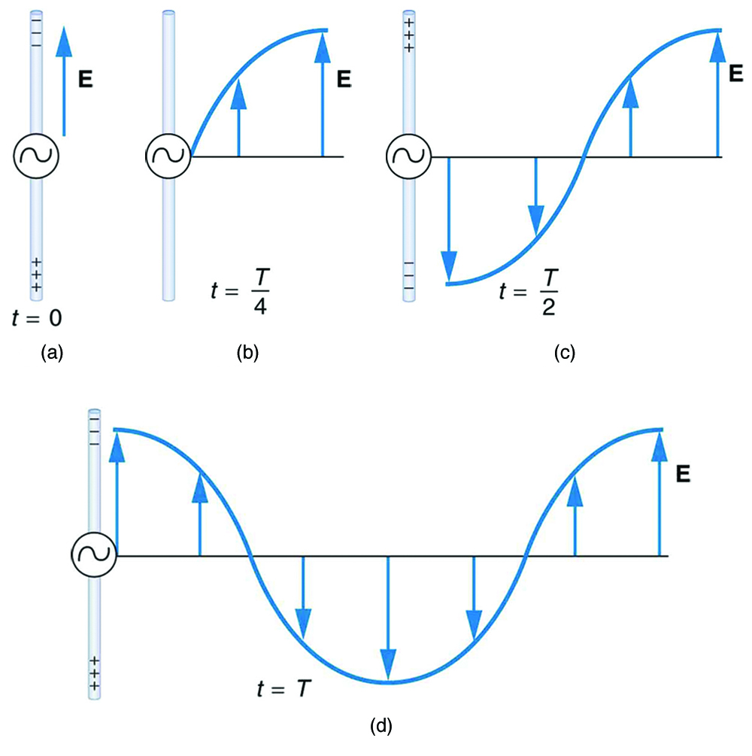
P
Q
P
P
Q
P
Q

Slide 8
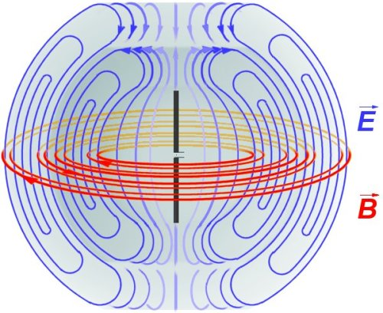

Slide 9
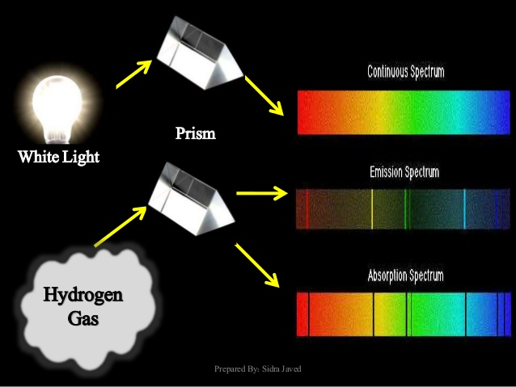
continuous spectrum
prism
white light
emission spectrum
absorption spectrum

Slide 10
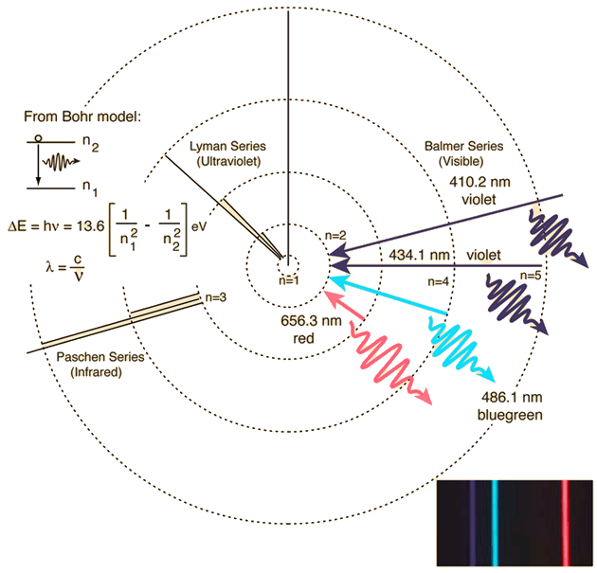

Slide 11
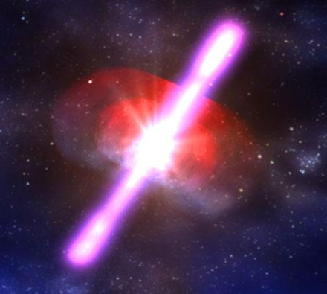
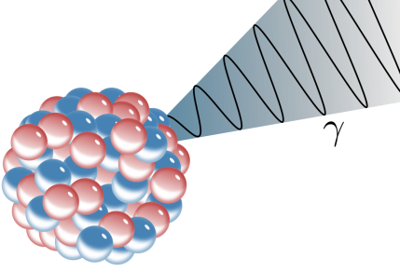
are emitted from the nuclei
Computer generated image of a gamma-ray bursts from a distance part of the Universe.

Slide 12


detector loop
spark gap
radio wave
-
spark gap
capacitor
(Leyden jar)

Slide 13
λ / 2
reflecting
screen
radio source
frequency f
standing wave pattern

Slide 14
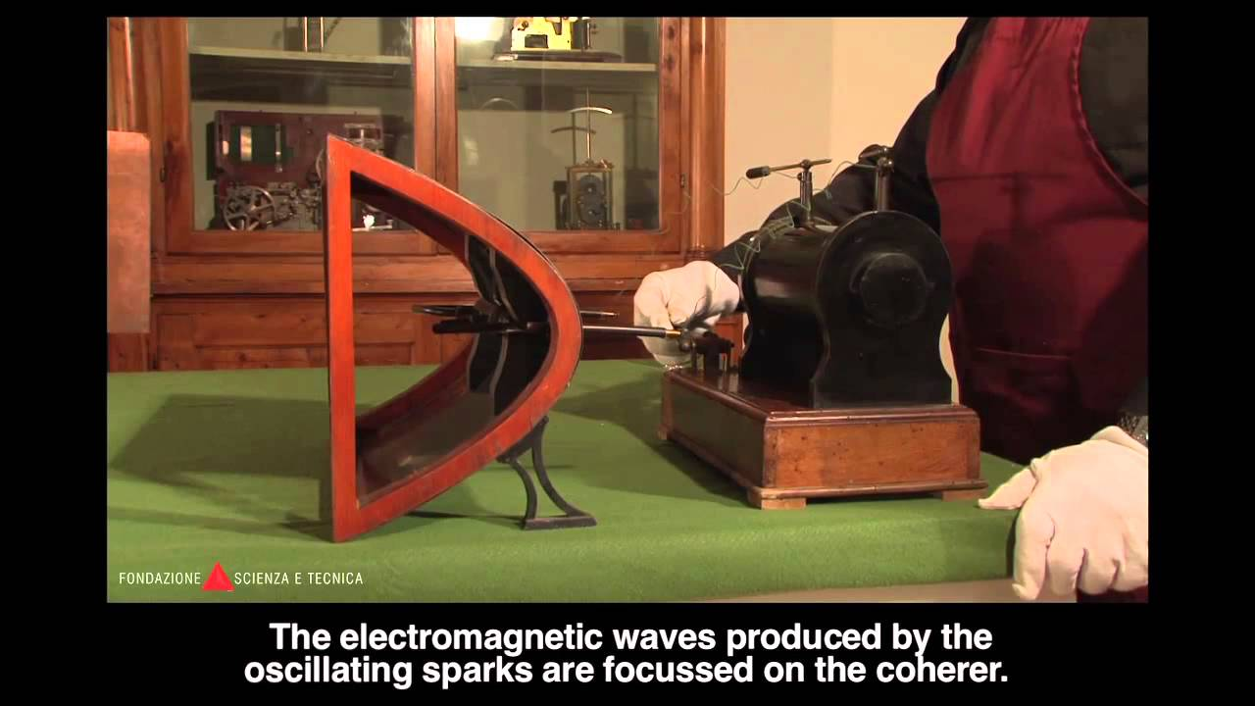
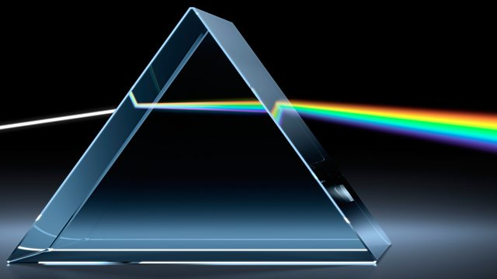

Slide 15
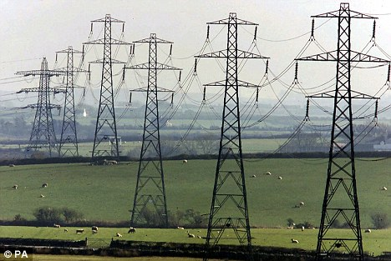
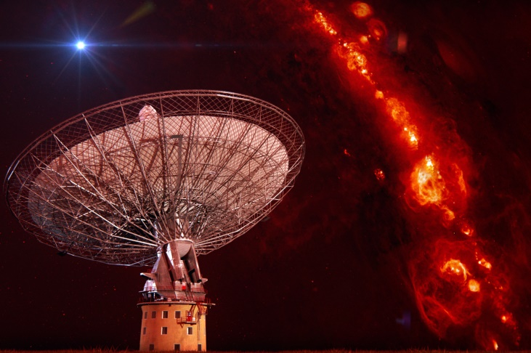

Slide 16
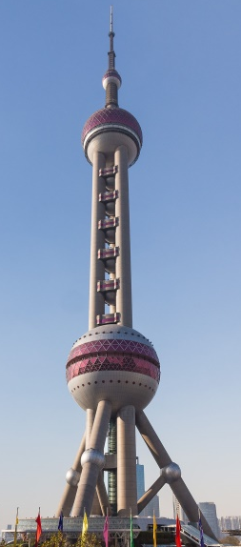
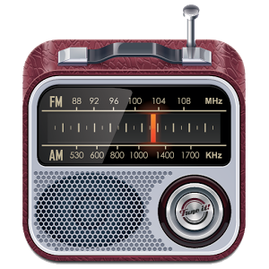
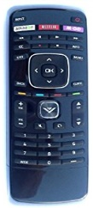

Slide 17
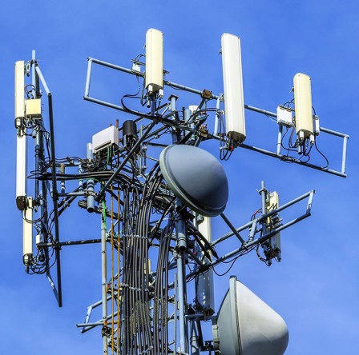
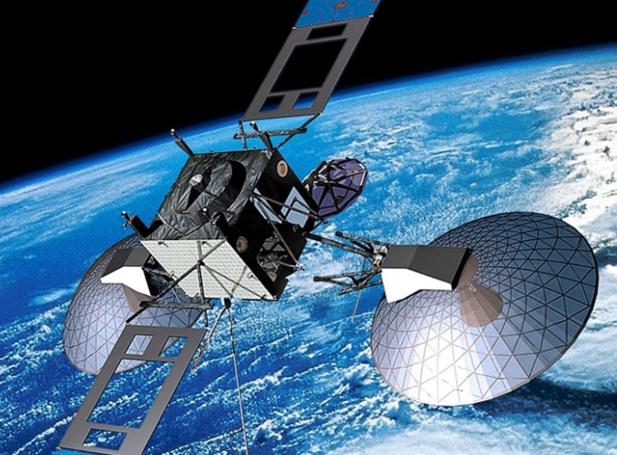

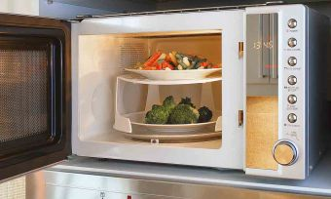

Slide 18
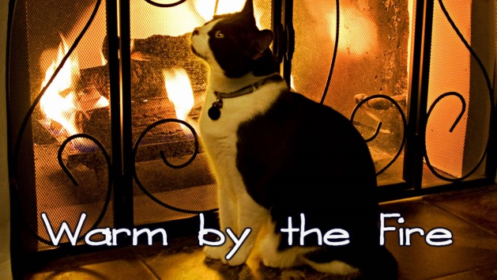
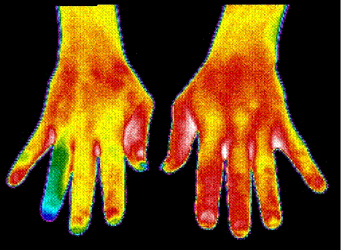
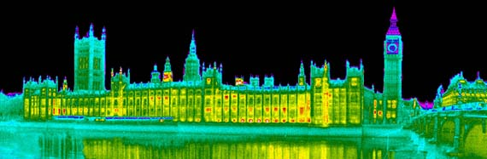
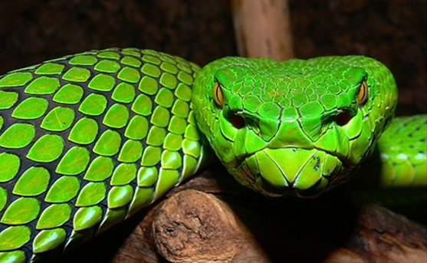
A pit viper has IR receptors

Slide 19
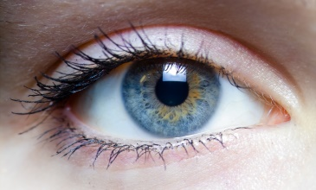
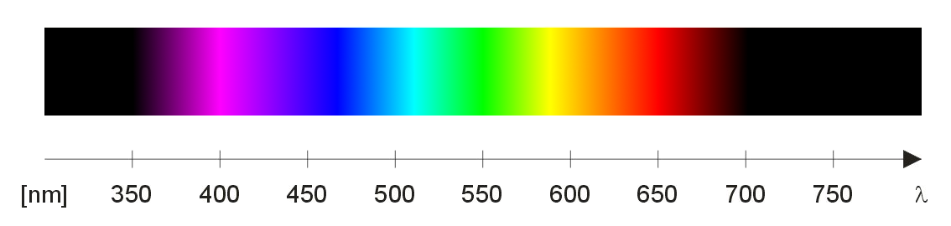

Slide 20
Star X
Star Y
m7A.pptx

Slide 21
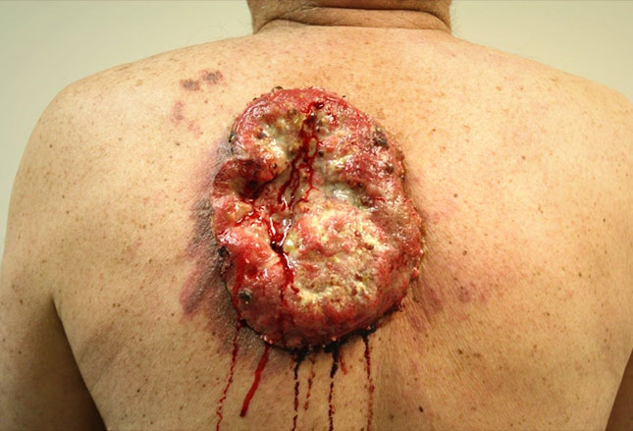
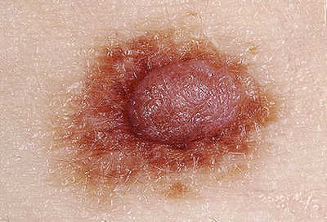
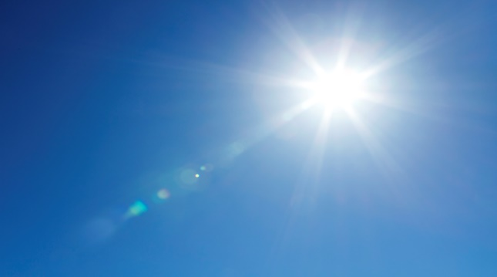
UV radiation damage can lead to cancerous growths
Be careful of too much sunlight

Slide 22
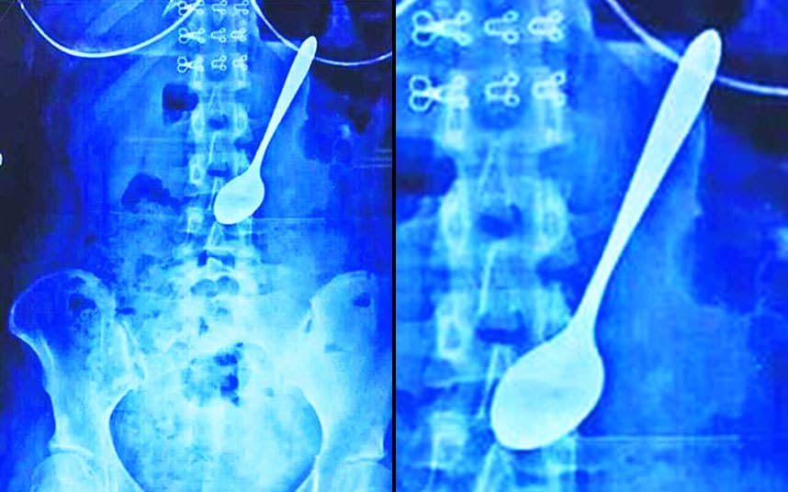
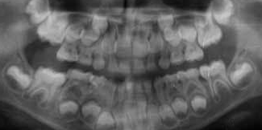
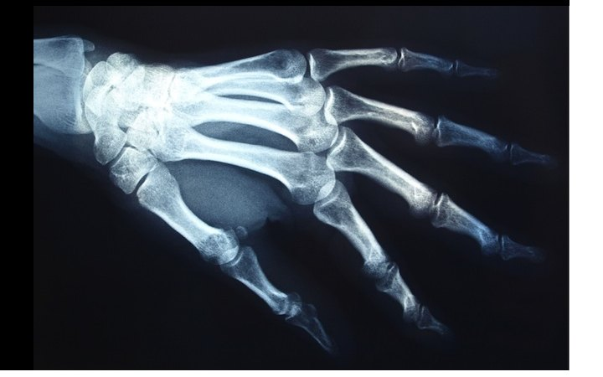


Slide 23
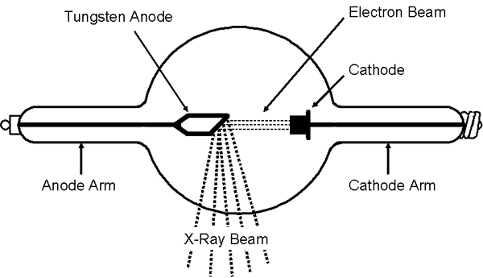
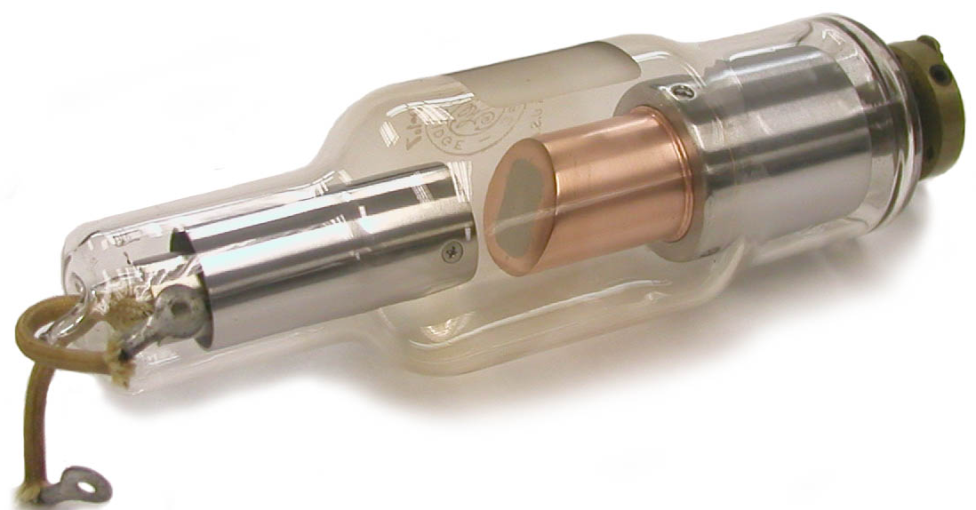

Slide 24
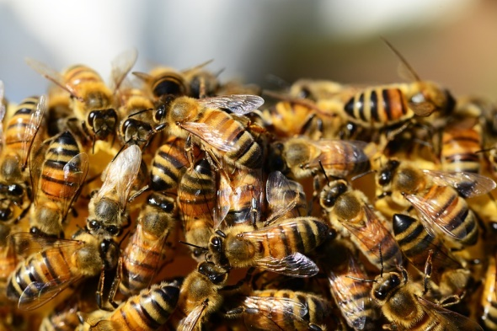


Slide 25
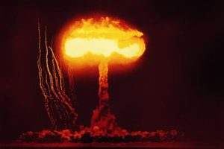
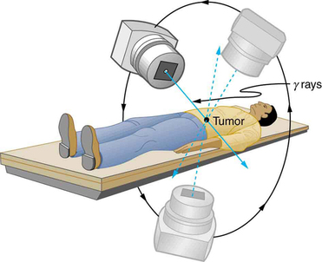
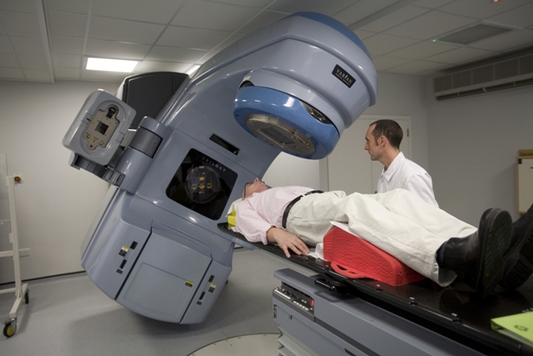

Slide 26
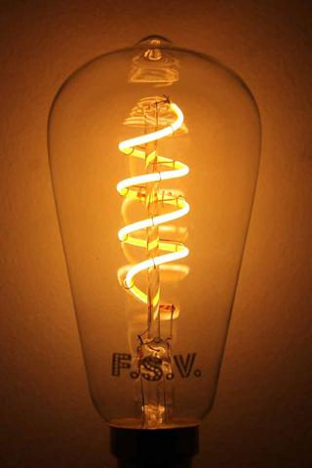
Most of the radiation is in the IR band and not visible light

Slide 27
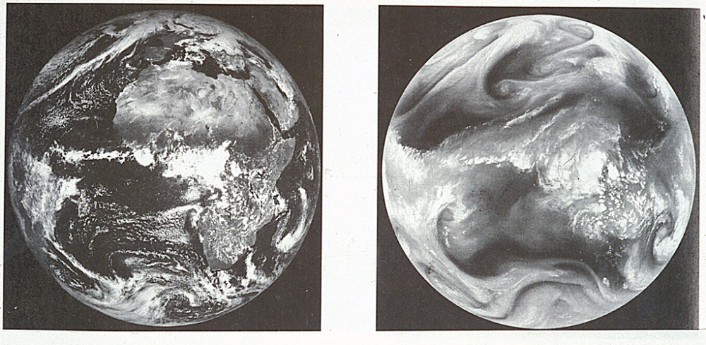
Images of the Earth from reflected sunlight
Visible: dark indicates absorption by water
IR: dark indicates absorption by water vapour in the atmosphere

Slide 28
visible
FM
AM
γ-rays
X-rays
UV
IR
micro-
wave
radio wave
longwave
10²⁰
10¹⁸
10¹⁶
10¹⁴
10¹²
10¹⁰
10⁸
10⁶
10⁴
10²
10⁰
frequency [Hz]
nuclear transitions
electron transitions in atoms
vibrational transitions
rotational transitions
oscillations in electric circuits

Slide 29
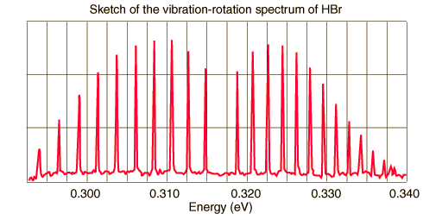
nucleus
atom
molecule:
transitions between closely spaced energy levels
photon
IR Vibrational-rotational spectrum of HBr
energy [eV]

Slide 30
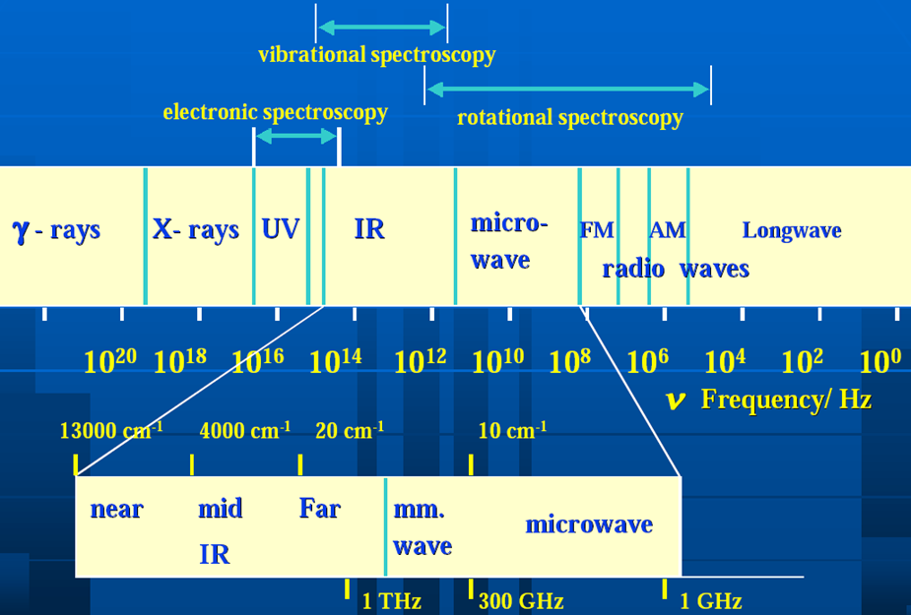

Slide 31
10⁴
assumes no atmosphere
10³
Earth’s
reflectance
Earth’s
emission
irradiance [W.m⁻².μm⁻¹]
10²
radiant exitance [W.m⁻².μm⁻¹]
10
1
0.1
0.3
0.7
1
3
5
7
10
30
wavelength [μm]

Slide 32
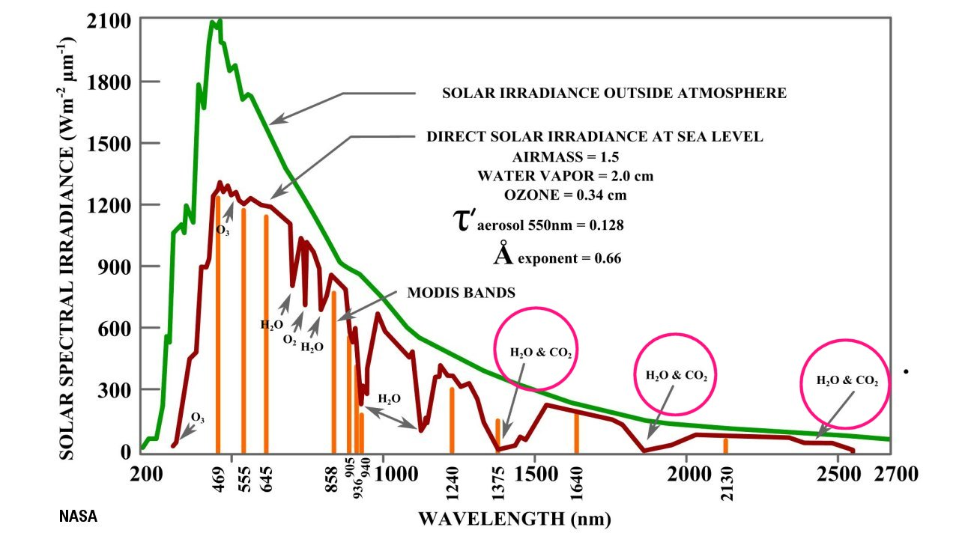

Slide 33
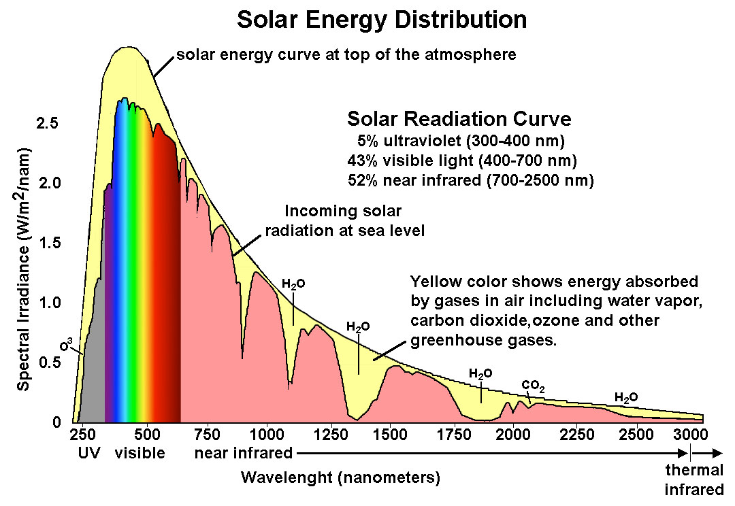

Slide 34
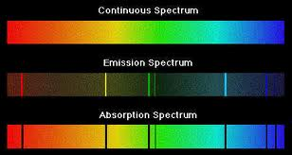
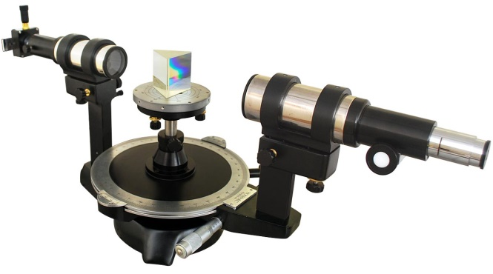
white light source
slit
prism
diffraction grating
continuous spectrum:
each colour represents a different wavelength

Slide 35
an accelerating electron radiates electromagnetic energy
+
negative electron attracted towards positive nucleus
spiral path of electron towards positive nucleus
Note: this classical model is wrong

Slide 36


sodium
potassium
strontium
barium
copper
selenium

Slide 37
short wavelength limit

Slide 39
Pfund series
IR
6
5
4
Brackett
series IR
3
Balmer series
visible
2
n
Lymann series
UV
-13.6
1

Slide 40
spectral lines vary in intensity
no magnetic field
ZEEMAN EFFECT
HYPERFINE SPLITTING
external
magnetic field
greatly magnified

Slide 41
atoms in ground state
collision → KE transferred into excitation energy
atoms in excited states
photons
atoms return to ground state emitting photons

Slide 42
gas
white light
transmitted light
absorbed (excitation) energy →
emission in random directions at specific wavelengths

Slide 43
mesh
electrode
collecting
electrode
heater
filament
G
retarding
voltage
variable accelerating
voltage

Slide 44

ultraviolet
infrared
400
450
5
00
550
6
00
650
700
750
wavelength (nm)

Slide 45
screen
cathode
glow
_
+
anode
high
voltage

Slide 46
_
deflection
plates V
+
heater
element
cathode
anode
X
6 Vac
_
d
Z
+
accelerating
voltage V_{A}
I
Y
coils to produce
B field into page

Slide 47

hot cathode
electrodes for voltage to
accelerate electrons
eleelectron beam
magnetic deflection
for focusing
magnetic deflection for
directing beam to screening
phosphorescent screen

Slide 48

reflecting screen
radio source
frequency f
λ / 2

Slide 49



Slide 50

Deflection by an electric field
negative plate
uniform electric field
positive plate
electron beam deflected towards positive electrode
Deflection by a magnetic field
Direction of force on electron determined by right hand palm rule
Electron beam deflected upwards
magnetic field out of page

Slide 51

cathode rays
anode (+)
cathode (
-
)
wheel spins clockwise

Slide 52

10⁴ Pa
10³ Pa
10² Pa
10 Pa
1 Pa

Slide 54


Slide 55

peak wavelength
envelope gives continuous spectrum
intensity [a.u.]
noise
absorption “valleys”
750 400
wavelength [nm]
IR
UV
resonant absorption
zero resonant absorption

Slide 56


Slide 57

400
500
600
700
800
900
wavelength [nm]

Slide 58


Slide 59


Slide 60

photosphere
A
A
A
A
hot dense interior

Slide 61


Slide 62

redshift: wavelength longer
blueshift: wavelength shorter

Slide 63


Slide 64


